Slide 1
Bayesian Inference
Chris Mathys
London SPM Course
Thanks to Jean Daunizeau and Jérémie Mattout for previous versions of this talk

Slide 2
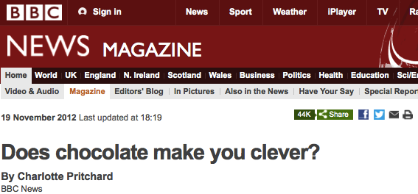
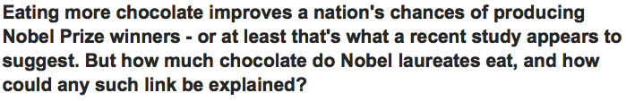
A surprising piece of information

Slide 3
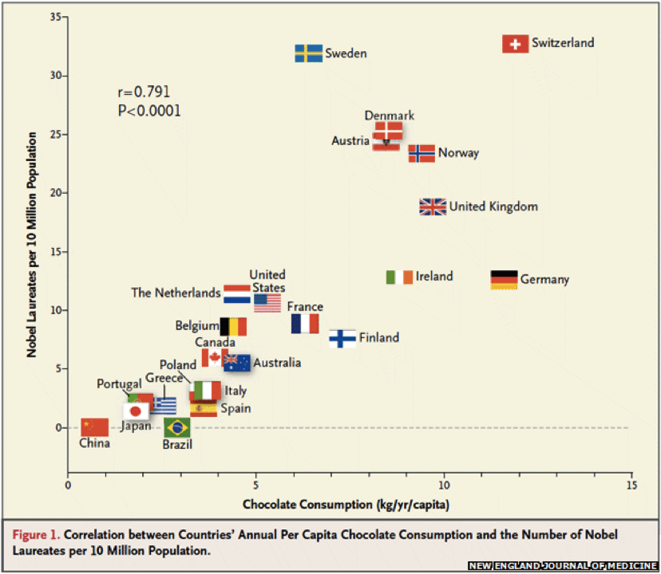
A surprising piece of information
Messerli, F. H. (2012). Chocolate Consumption, Cognitive Function, and Nobel Laureates. New England Journal of Medicine, 367(16), 1562–1564.

Slide 4
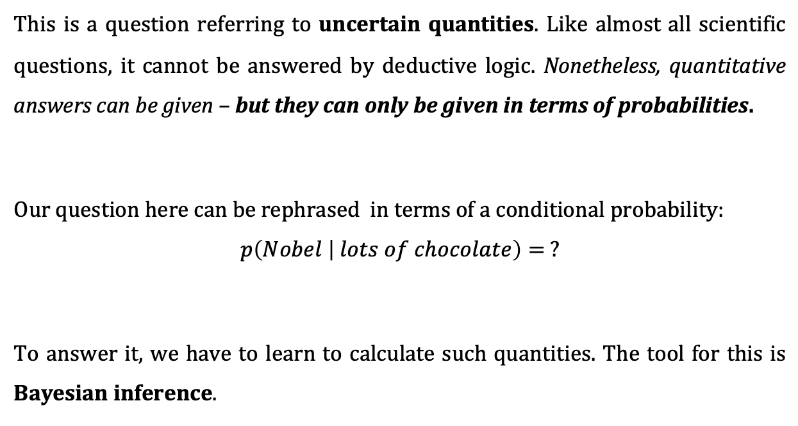
So will I win the Nobel prize if I eat lots of chocolate?
This is a question referring to uncertain quantities. Like almost all scientific questions, it cannot be answered by deductive logic. Nonetheless, quantitative answers can be given – but they can only be given in terms of probabilities.
Our question here can be rephrased in terms of a conditional probability:
$$p\left(Nobel | lots of chocolate\right)= ?$$
To answer it, we have to learn to calculate such quantities. The tool for this is Bayesian inference.

Slide 5




Calculating with probabilities: the setup
We assume a probability space $Ω$ with subsets $A$ and $B$
In order to understand the rules of probability, we need to understand three kinds of probabilities
Marginal probabilities like $p(A)$
Joint probabilities like $p(A,B)$
Conditional probabilities like $p(B|A)$
$$A$$
$$B$$
$$Ω$$

Slide 6





Marginal probabilities
$$p(A)$$
$$A$$
$$A$$
$$B$$
$$Ω$$

Slide 7

Joint probabilities
$$p(A,B)$$
$$A$$
$$B$$
$$Ω$$

Slide 8

What is ‘marginal’ about marginal probabilities?
Let $A$ be the statement ‘the sun is shining’
Let $B$ be the statement ‘it is raining’
$\overline{A}$ negates $A$, $\overline{B}$ negates $B$
Consider the following table of joint probabilities:
Marginal probabilities get their name from being at the margins of tables such as this one.

Slide 9
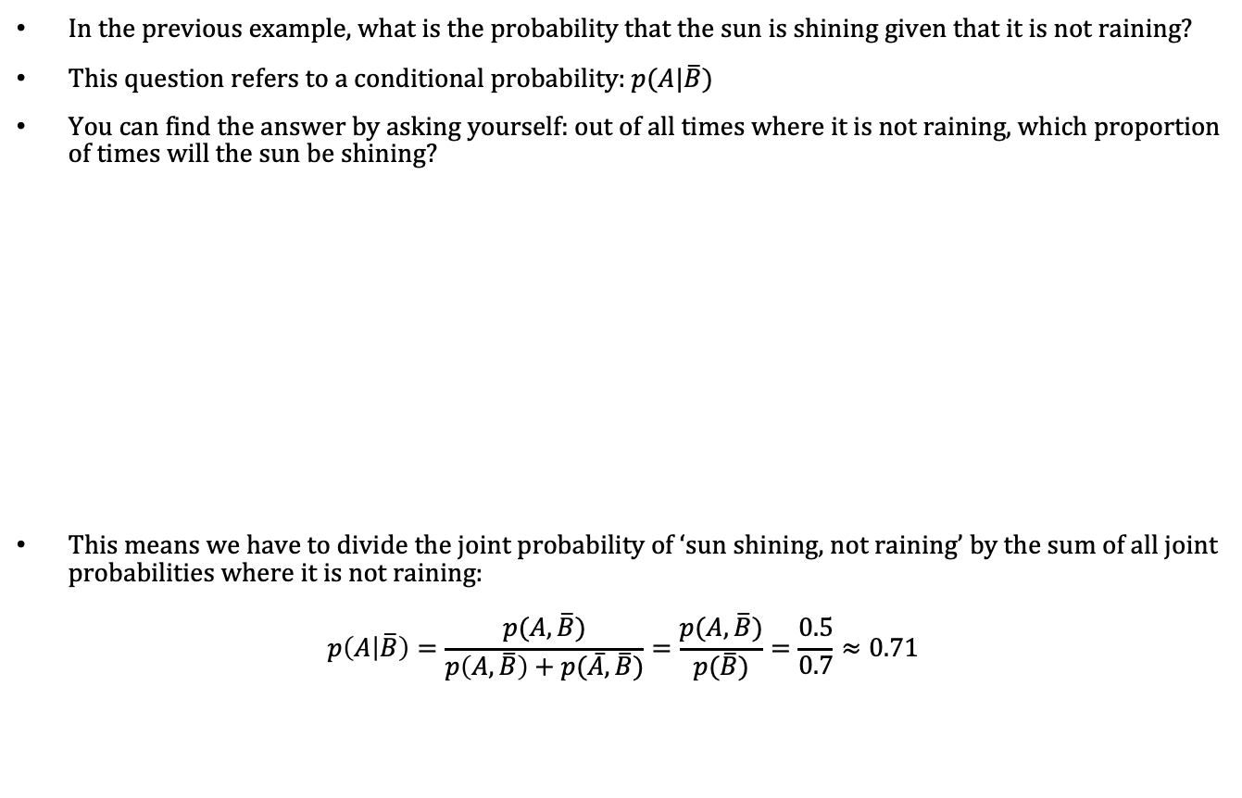
Conditional probabilities
In the previous example, what is the probability that the sun is shining given that it is not raining?
This question refers to a conditional probability: $p(A|\overline{B})$
You can find the answer by asking yourself: out of all times where it is not raining, which proportion of times will the sun be shining?
This means we have to divide the joint probability of ‘sun shining, not raining’ by the sum of all joint probabilities where it is not raining:
$$p\left(A | \overline{B}\right)=\frac{p(A,\overline{B})}{p\left(A,\overline{B}\right)+p(\overline{A},\overline{B})}=\frac{p(A,\overline{B})}{p(\overline{B})}=\frac{0.5}{0.7}≈0.71$$

Slide 10
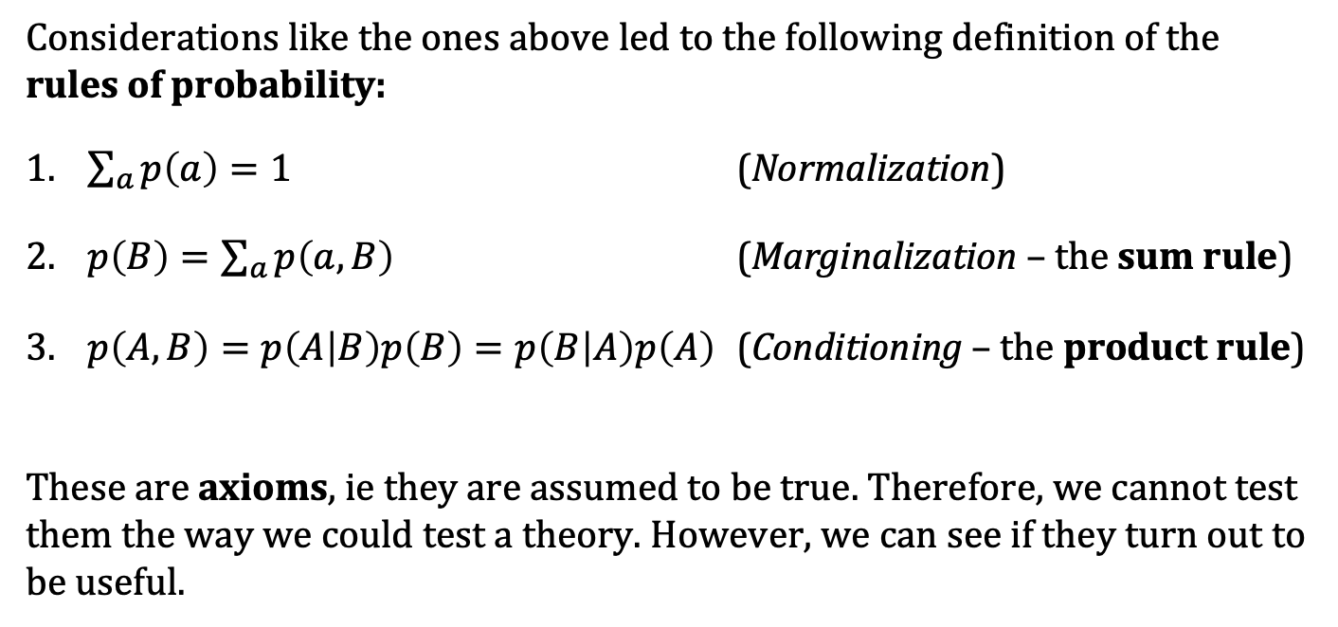
The rules of probability
Considerations like the ones above led to the following definition of the rules of probability:
$\sum_{a}{p\left(a\right)=1}$ (Normalization)
$p\left(B\right)=\sum_{a}{p\left(a,B\right)}$ (Marginalization – the sum rule)
$p\left(A,B\right)=p\left(A | B\right)p\left(B\right)=p\left(B | A\right)p\left(A\right)$ (Conditioning – the product rule)
These are axioms, ie they are assumed to be true. Therefore, we cannot test them the way we could test a theory. However, we can see if they turn out to be useful.

Slide 11
The rules of probability
R. T. Cox showed in 1946 that the rules of probability theory can be derived from three basic desiderata:
Representation of degrees of plausibility by real numbers
Qualitative correspondence with common sense (in a well-defined sense)
Consistency
By mathematical proof (i.e., by deductive reasoning) the three desiderata as set out by Cox imply the rules of probability (i.e., the rules of inductive reasoning).
This means that anyone who accepts the desiderata must accept the rules of probability.
«Probability theory is nothing but common sense reduced to calculation.»
— Pierre-Simon Laplace, 1819

Slide 12
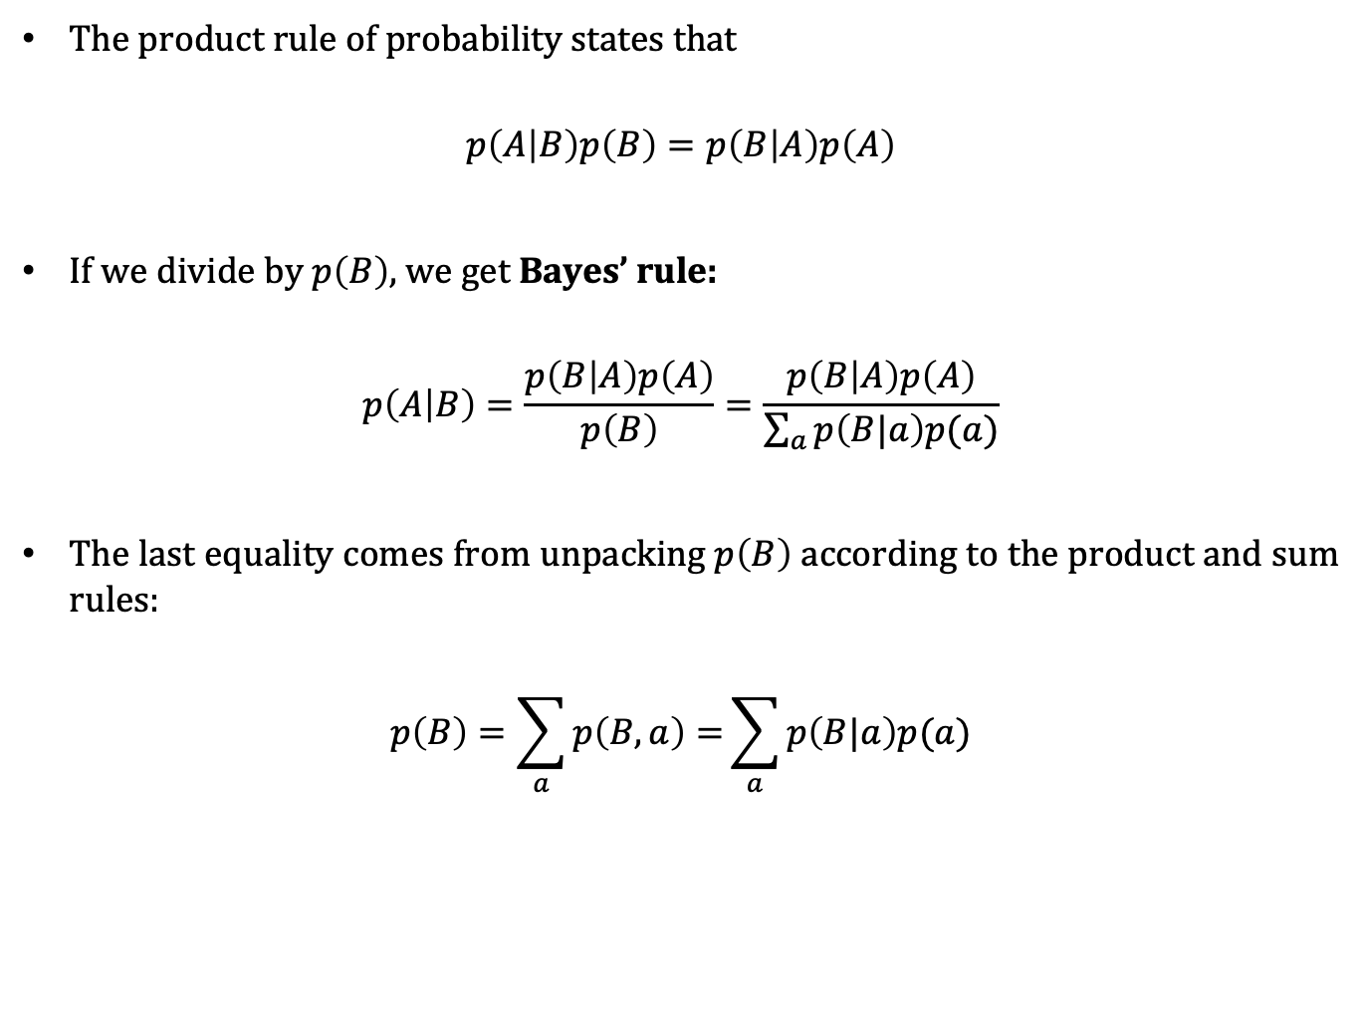
Bayes’ rule
The product rule of probability states that
$$p\left(A | B\right)p\left(B\right)=p\left(B | A\right)p\left(A\right)$$
If we divide by $p\left(B\right)$, we get Bayes’ rule:
$$p\left(A | B\right)=\frac{p\left(B | A\right)p\left(A\right)}{p\left(B\right)}=\frac{p\left(B | A\right)p\left(A\right)}{\sum_{a}{p\left(B|a\right)p(a)}}$$
The last equality comes from unpacking $p\left(B\right)$ according to the product and sum rules:
$$p\left(B\right)=\sum_{a}{p\left(B,a\right)=}\sum_{a}{p\left(B|a\right)p(a)}$$

Slide 13
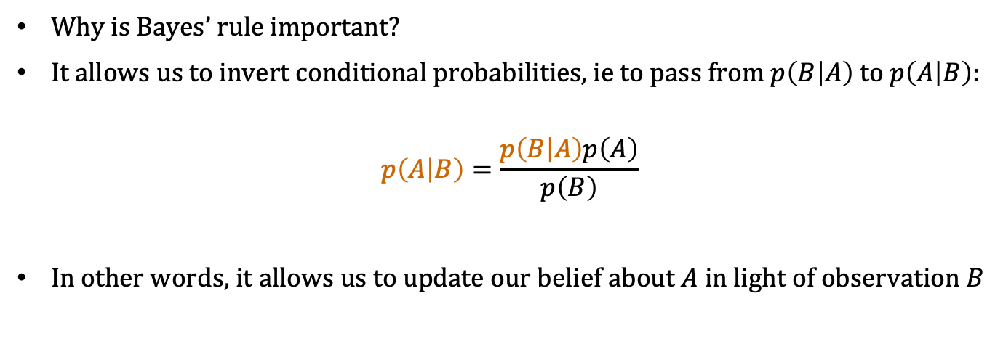
Bayes’ rule: what problem does it solve?
Why is Bayes’ rule important?
It allows us to invert conditional probabilities, ie to pass from $p\left(B | A\right)$ to $p\left(A | B\right):$
$$p\left(A | B\right)=\frac{p\left(B | A\right)p\left(A\right)}{p\left(B\right)}$$
In other words, it allows us to update our belief about $A$ in light of observation $B$

Slide 14
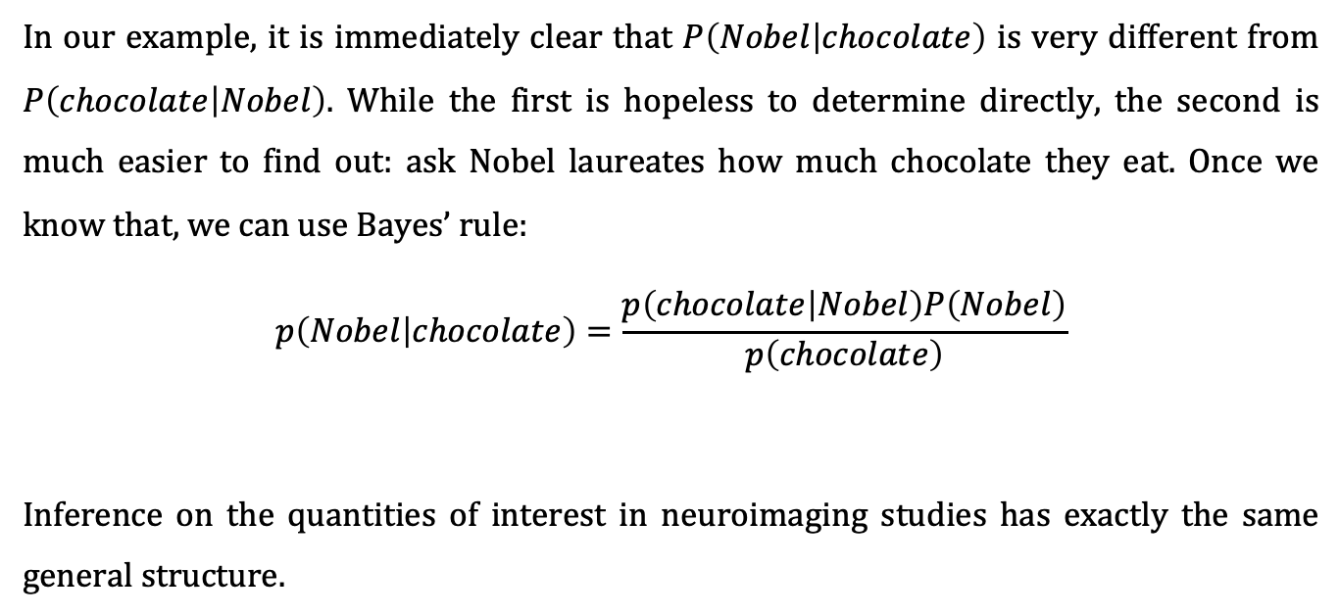
Bayes’ rule: the chocolate example
In our example, it is immediately clear that $P\left(Nobel | chocolate\right)$ is very different from $P\left(chocolate | Nobel\right)$. While the first is hopeless to determine directly, the second is much easier to find out: ask Nobel laureates how much chocolate they eat. Once we know that, we can use Bayes’ rule:
$$p\left(Nobel | chocolate\right)=\frac{p\left(chocolate | Nobel\right)P\left(Nobel\right)}{p\left(chocolate\right)}$$
Inference on the quantities of interest in neuroimaging studies has exactly the same general structure.
likelihood
model
prior
posterior
evidence

Slide 15
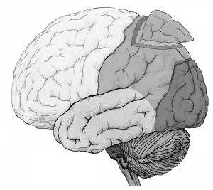
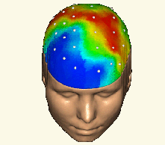


Inference in SPM
forward problem
$$p\left(y | θ,m\right)$$
likelihood
posterior distribution
$$p\left(θ | y,m\right)$$
inverse problem
Notes:
15

Slide 16
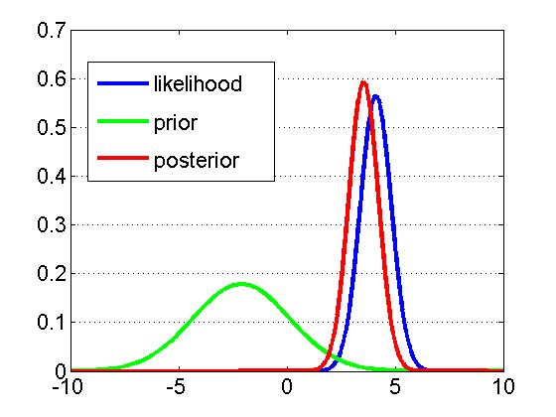
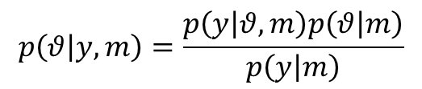



Inference in SPM
Likelihood:
$$p\left(y | θ,m\right)$$
Prior:
$$p\left(θ | m\right)$$
$$p\left(θ | y,m\right)=\frac{p\left(y | θ,m\right)p\left(θ | m\right)}{p\left(y | m\right)}$$
Bayes’ theorem:
generative model $m$

Slide 17


A simple example of Bayesian inference
(adapted from Jaynes (1976))
Two manufacturers, A and B, deliver the same kind of components that turn out to have the following lifetimes (in hours):
A:
B:
Assuming prices are comparable, from which manufacturer would you buy?

Slide 18
A simple example of Bayesian inference
How do we compare such samples?
By comparing their arithmetic means
Why do we take means?
If we take the mean as our estimate, the error in our estimate is the mean of the errors in the individual measurements
Taking the mean as maximum-likelihood estimate implies a Gaussian error distribution
A Gaussian error distribution appropriately reflects our prior knowledge about the errors whenever we know nothing about them except perhaps their variance

Slide 19








A simple example of Bayesian inference
What next?
Let’s do a t-test (but first, let’s compare variances with an F-test):
Is this satisfactory? No, so what can we learn by turning to probability theory (i.e., Bayesian inference)?
Variances not significantly different!
Means not significantly different!

Slide 20
A simple example of Bayesian inference
The procedure in brief:
Determine your question of interest («What is the probability that...?»)
Specify your model (likelihood and prior)
Calculate the posterior using Bayes’ theorem
Ask your question of interest of the posterior
All you need is the rules of probability theory.
(Sometimes you’ll encounter a nasty integral. But that’s only a technical difficulty, not a conceptual one, and software packages like SPM will solve it for you – normally).

Slide 21
A simple example of Bayesian inference
The question:
What is the probability that the components from manufacturer B have a longer lifetime than those from manufacturer A?
More specifically: given how much more expensive they are, how much longer do I require the components from B to live.
Example of a decision rule: if the components from B live 3 hours longer than those from A with a probability of at least 80%, I will choose those from B.

Slide 22
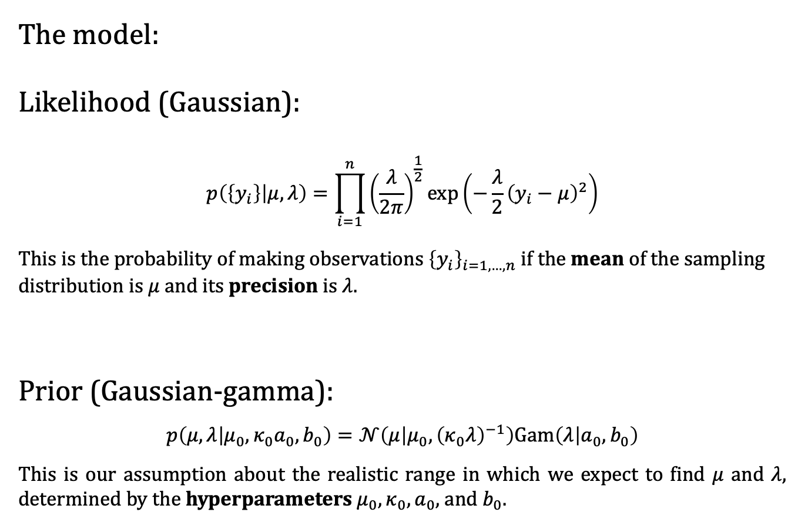
A simple example of Bayesian inference
The model:
Likelihood (Gaussian):
$$p\left(\left\{y_{i}\right\} | μ,λ\right)=\prod_{i=1}^{n}{{\left(\frac{λ}{2π}\right)}^{\frac{1}{2}}}\exp\left(−\frac{λ}{2}{\left(y_{i}−μ\right)}^{2}\right)$$
This is the probability of making observations ${\left\{y_{i}\right\}}_{i=1,…,n}$ if the mean of the sampling distribution is $μ$ and its precision is $λ$.
Prior (Gaussian-gamma):
$$p\left(μ,λ | μ_{0},κ_{0}a_{0},b_{0}\right)=𝒩\left(μ | μ_{0},{\left(κ_{0}λ\right)}^{−1}\right)Gam\left(λ | a_{0},b_{0}\right)$$
This is our assumption about the realistic range in which we expect to find $μ$ and $λ$, determined by the hyperparameters $μ_{0},κ_{0},a_{0}$, and $b_{0}$.

Slide 23
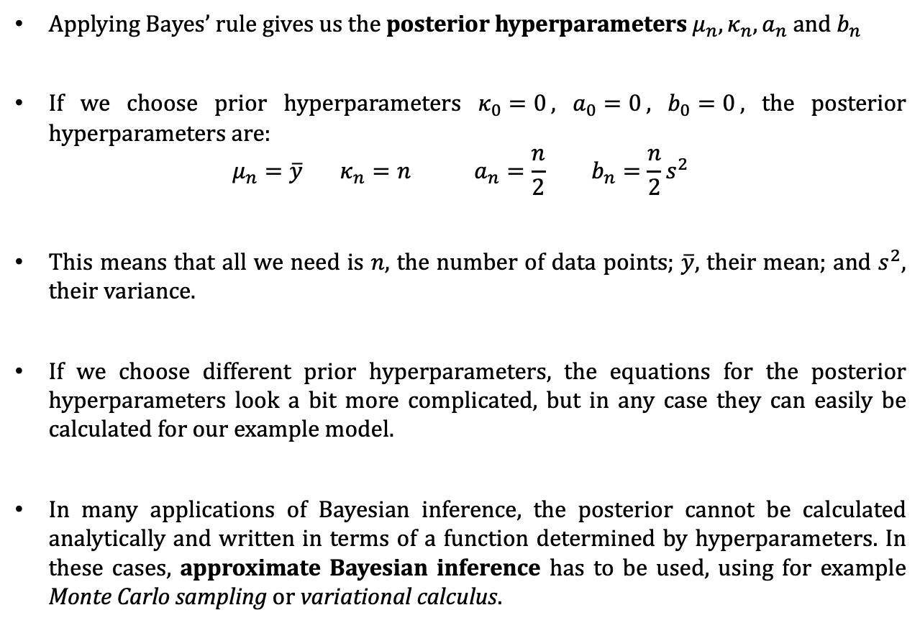
A simple example of Bayesian inference
Applying Bayes’ rule gives us the posterior hyperparameters $μ_{n},κ_{n}{,a}_{n}$ and $b_{n}$
If we choose prior hyperparameters $κ_{0}=0$, $a_{0}=0$, $b_{0}=0$, the posterior hyperparameters are:
$$μ_{n}=\overline{y} κ_{n}=n a_{n}=\frac{n}{2} b_{n}=\frac{n}{2}s^{2}$$
This means that all we need is $n$, the number of data points; $\overline{y}$, their mean; and $s^{2}$, their variance.
If we choose different prior hyperparameters, the equations for the posterior hyperparameters look a bit more complicated, but in any case they can easily be calculated for our example model.
In many applications of Bayesian inference, the posterior cannot be calculated analytically and written in terms of a function determined by hyperparameters. In these cases, approximate Bayesian inference has to be used, using for example Monte Carlo sampling or variational calculus.

Slide 24
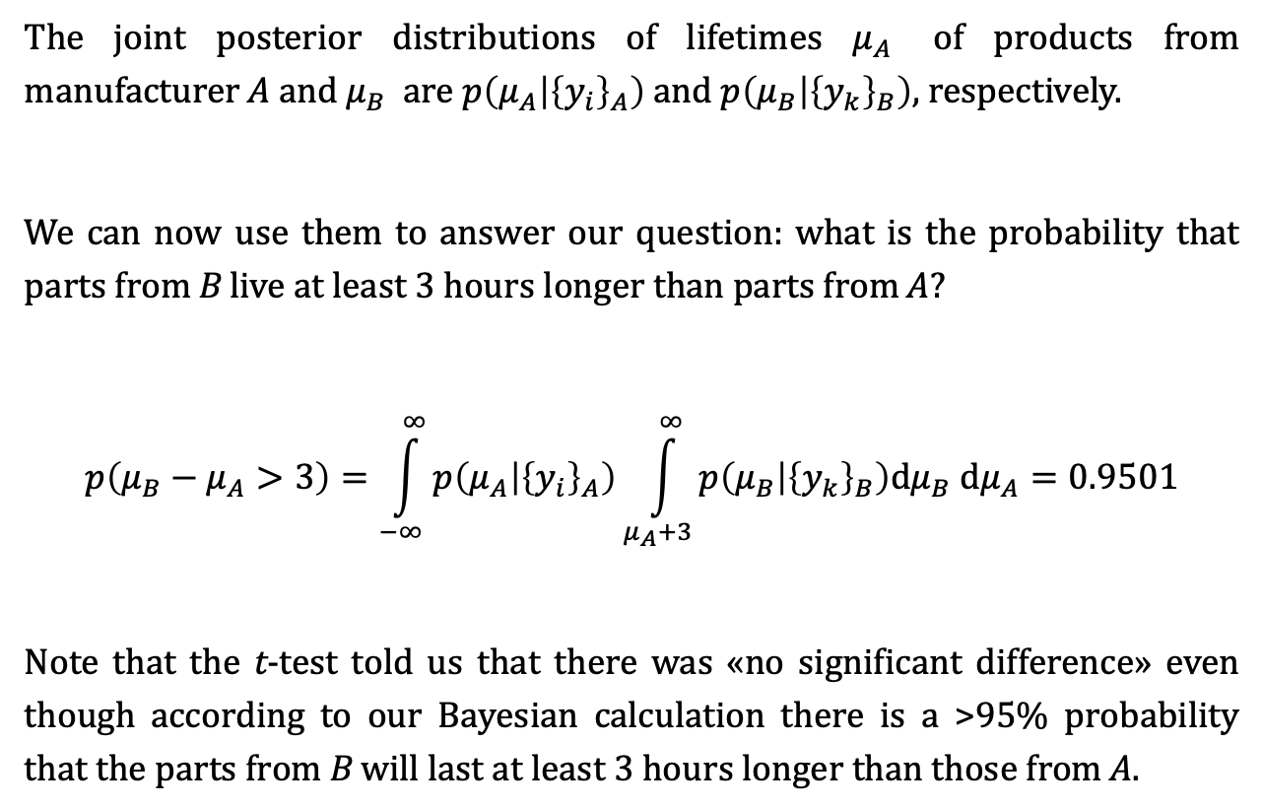
A simple example of Bayesian inference
The joint posterior distributions of lifetimes $μ_{A}$ of products from manufacturer A and $μ_{B}$ are $p\left(μ_{A} | {\left\{y_{i}\right\}}_{A}\right)$ and $p\left(μ_{B} | {\left\{y_{k}\right\}}_{B}\right)$, respectively.
We can now use them to answer our question: what is the probability that parts from B live at least 3 hours longer than parts from A?
$$p\left(μ_{B}−μ_{A}>3\right)=\int_{−∞}^{∞}{p\left(μ_{A} | {\left\{y_{i}\right\}}_{A}\right)}\int_{μ_{A}+3}^{∞}{p\left(μ_{B} | {\left\{y_{k}\right\}}_{B}\right)dμ_{B} dμ_{A}}=0.9501$$
Note that the t-test told us that there was «no significant difference» even though according to our Bayesian calculation there is a >95% probability that the parts from B will last at least 3 hours longer than those from A.

Slide 25
Bayesian inference
The procedure in brief:
Determine your question of interest («What is the probability that...?»)
Specify your model (likelihood and prior)
Ask your question of interest of the posterior
All you need is the rules of probability theory.

Slide 26
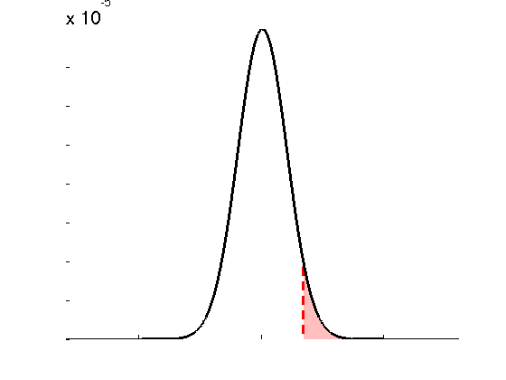
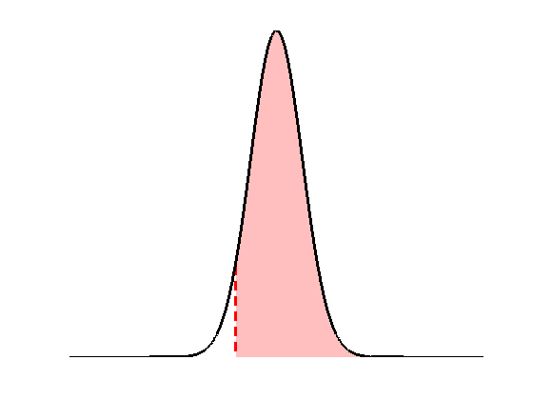













Frequentist (or: orthodox, classical) versus Bayesian inference: hypothesis testing
Classical
Bayesian
• define the null, e.g.:
$$H_{0}:θ=0$$
• invert model (obtain posterior pdf)
$$p\left(t | H_{0}\right)$$
$$p\left(θ | y\right)$$
$$p\left(H_{0} | y\right)$$
$$p\left(t>t^{∗} | H_{0}\right)$$
$$t≡t\left(Y\right)$$
$$θ$$
$$t^{∗}$$
$$θ_{0}$$
• estimate parameters (obtain test stat. $t^{∗}$)
• define the null, e.g.:
$$H_{0}:θ>θ_{0}$$
• apply decision rule, i.e.:
• apply decision rule, i.e.:
if
$$p\left(t>t^{∗} | H_{0}\right)≤α$$
then reject H₀
if
$$p\left(H_{0} | y\right)≥α$$
then accept H₀

Slide 27
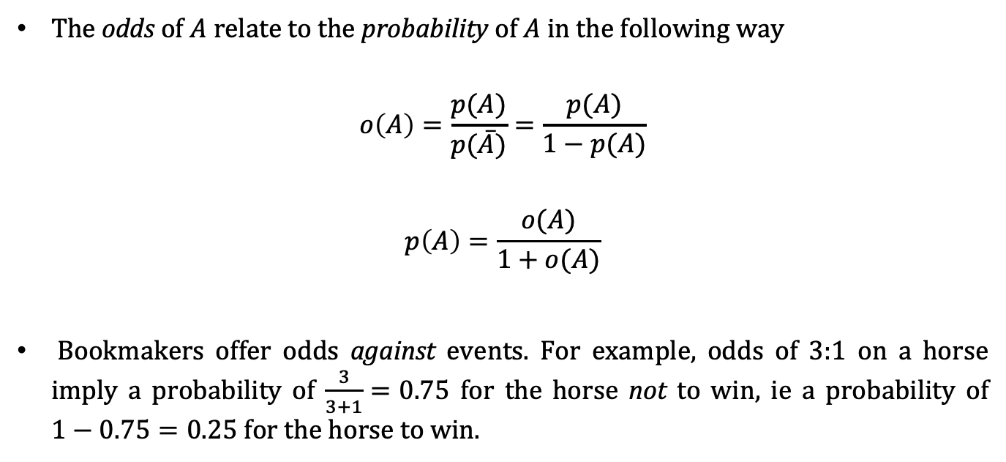
Bayes’ rule for odds
The odds of $A$ relate to the probability of $A$ in the following way
$$o\left(A\right)=\frac{p(A)}{p(\overline{A})}=\frac{p(A)}{1−p(A)}$$
$$p\left(A\right)=\frac{o(A)}{1+o(A)}$$
Bookmakers offer odds against events. For example, odds of 3:1 on a horse imply a probability of $\frac{3}{3+1}=0.75$ for the horse not to win, ie a probability of $1−0.75=0.25$ for the horse to win.

Slide 28
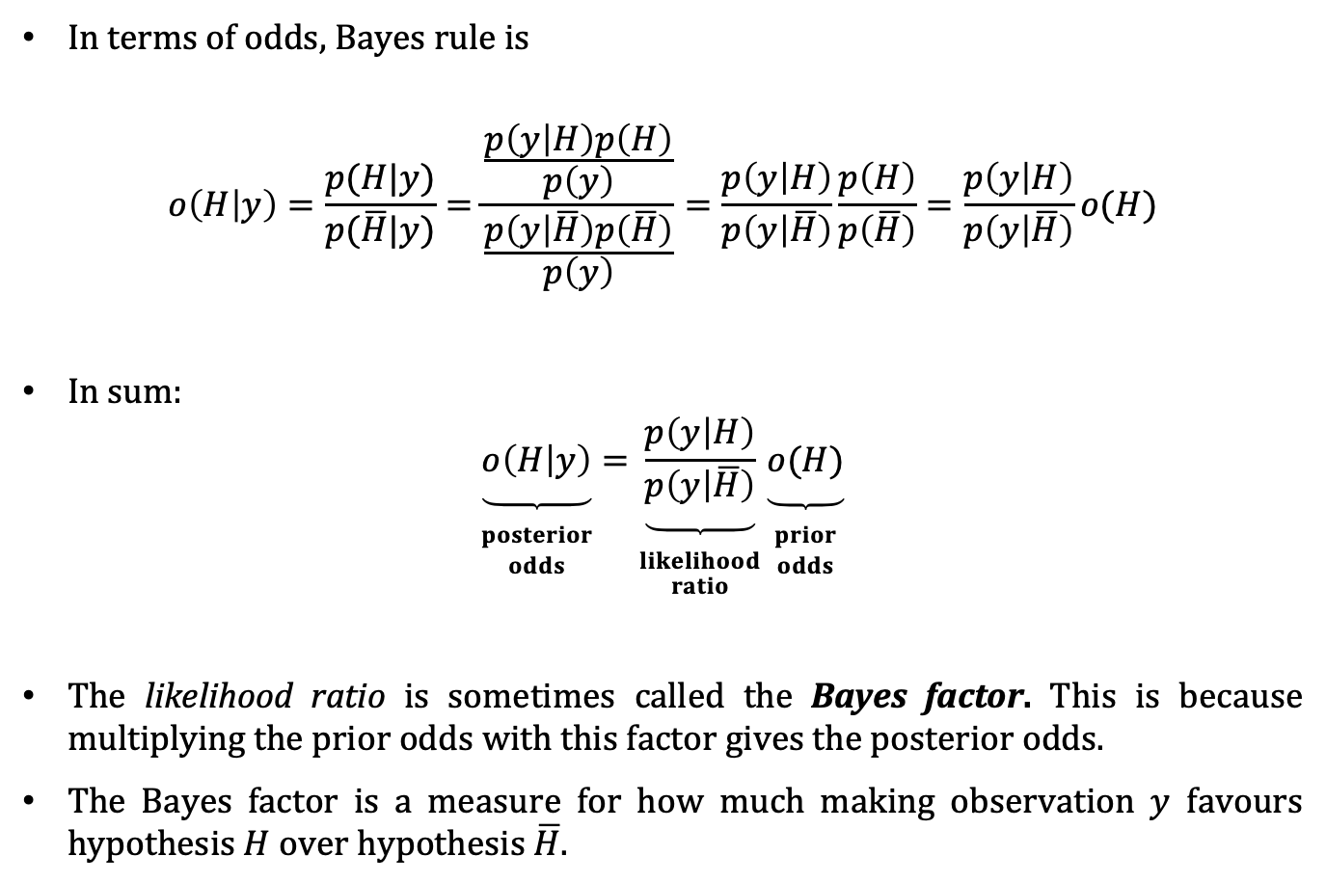
Bayes’ rule for odds
In terms of odds, Bayes rule is
$$o\left(H | y\right)=\frac{p(H|y)}{p(\overline{H}|y)}=\frac{\frac{p\left(y | H\right)p\left(H\right)}{p\left(y\right)}}{\frac{p\left(y | \overline{H}\right)p\left(\overline{H}\right)}{p\left(y\right)}}=\frac{p\left(y | H\right)}{p\left(y | \overline{H}\right)}\frac{p\left(H\right)}{p\left(\overline{H}\right)}=\frac{p\left(y | H\right)}{p\left(y | \overline{H}\right)}o(H)$$
In sum:
$$\underset{\begin{aligned} \\ posterior \\ odds\end{aligned}}{\underbrace{o\left(H | y\right)}}=\underset{\begin{aligned} \\ likelihood \\ ratio\end{aligned}}{\underbrace{\frac{p\left(y | H\right)}{p\left(y | \overline{H}\right)}}}\underset{\begin{aligned} \\ prior \\ odds\end{aligned}}{\underbrace{o(H)}}$$
The likelihood ratio is sometimes called the Bayes factor. This is because multiplying the prior odds with this factor gives the posterior odds.
The Bayes factor is a measure for how much making observation $y$ favours hypothesis $H$ over hypothesis$\overline{H}$.

Slide 29
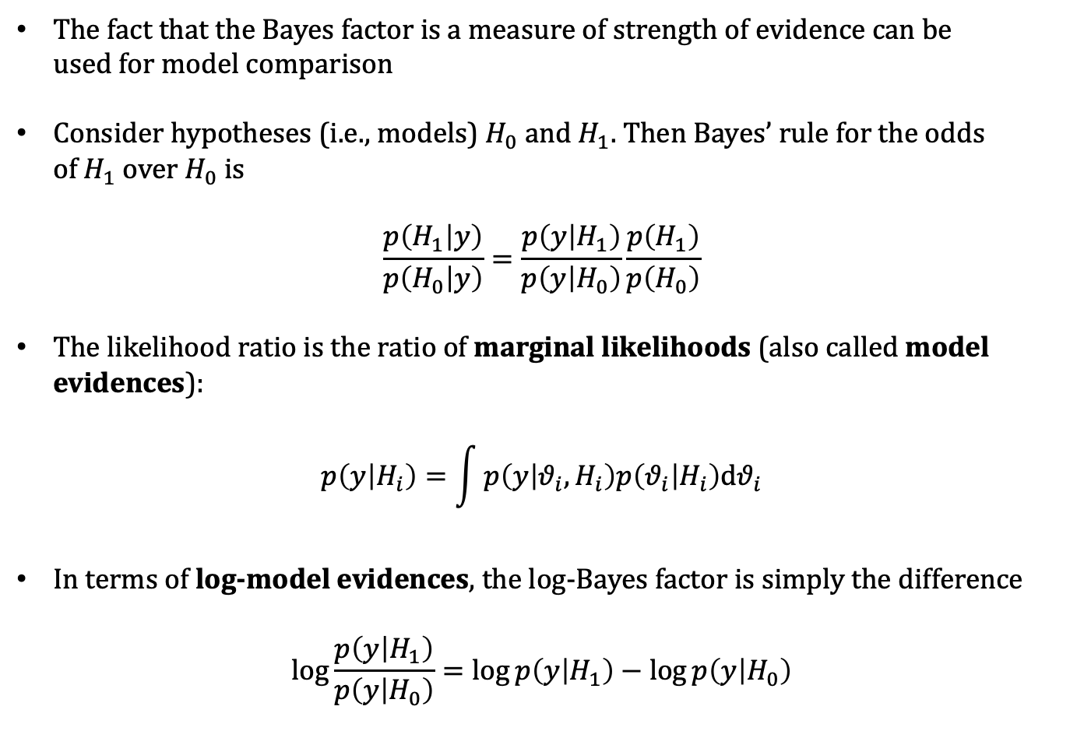
Model comparison
The fact that the Bayes factor is a measure of strength of evidence can be used for model comparison
Consider hypotheses (i.e., models) $H_{0}$ and $H_{1}$. Then Bayes’ rule for the odds of $H_{1}$ over $H_{0}$ is
$$\frac{p\left(H_{1} | y\right)}{p\left(H_{0} | y\right)}=\frac{p\left(y | H_{1}\right)}{p\left(y | H_{0}\right)}\frac{p\left(H_{1}\right)}{p\left(H_{0}\right)}$$
The likelihood ratio is the ratio of marginal likelihoods (also called model evidences):
$$p\left(y | H_{i}\right)=\int{p\left(y | θ_{i},H_{i}\right)p\left(θ_{i} | H_{i}\right)dθ_{i}}$$
In terms of log-model evidences, the log-Bayes factor is simply the difference
$$\log{\frac{p\left(y | H_{1}\right)}{p\left(y | H_{0}\right)}}=\log{p\left(y | H_{1}\right)−\log{p\left(y | H_{0}\right)}}$$

Slide 30
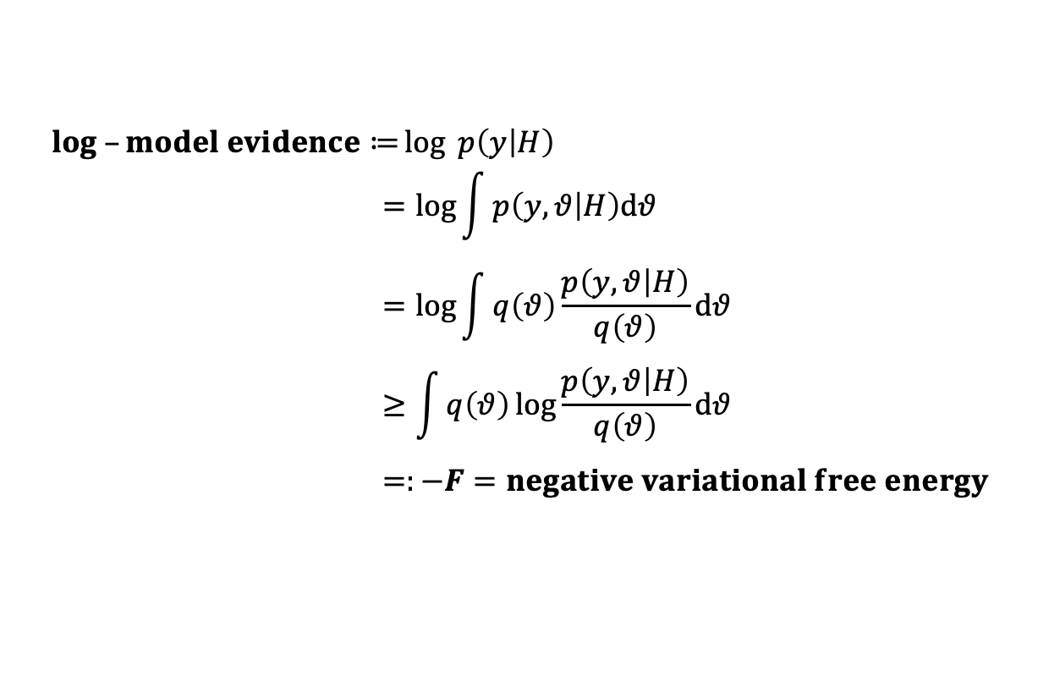
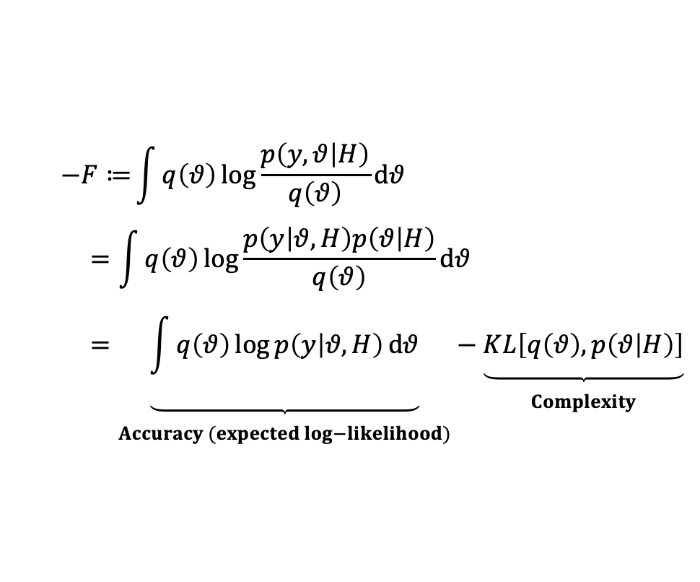

Model comparison: negative variational free energy F
$$log –model evidence≔\log{ p\left(y | H\right)} \\ =\log{\int{p\left(y,θ | H\right)dθ}} \\ =\log{\int{q\left(θ\right)\frac{p\left(y,θ | H\right)}{q\left(θ\right)}dθ}} \\ ≥\int{q\left(θ\right)\log{\frac{p\left(y,θ | H\right)}{q\left(θ\right)}}dθ} \\ =:−F=negative variational free energy$$
sum rule
a lower bound on the
log-model evidence
multiply by $1=\frac{q\left(θ\right)}{q\left(θ\right)}$
Jensen’s inequality
$$−F≔\int{q\left(θ\right)\log{\frac{p\left(y,θ | H\right)}{q\left(θ\right)}}dθ} \\ =\int{q\left(θ\right)\log{\frac{p\left(y | θ,H\right)p\left(θ | H\right)}{q\left(θ\right)}}dθ} \\ =\underset{\begin{aligned} \\ Accuracy (expected log−likelihood)\end{aligned}}{\underbrace{\int{q\left(θ\right)\log{p\left(y | θ,H\right)}dθ}}}−\underset{\begin{aligned} \\ Complexity\end{aligned}}{\underbrace{KL\left[q\left(θ\right),p\left(θ | H\right)\right]}}$$
Kullback-Leibler divergence
product rule

Slide 31
Remarks on model comparison / model selection
There is a range of scores that help in choosing a well-performing model: AIC (Akaike information criterion), BIC (Bayesian information criterion), Bayes factors, LME (log-model evidence), free energy, etc.
Each model gets a particular score (which is on its own uninterpretable!)
The difference in score between models is what counts
However, model selection is not straightforward. AIC and BIC penalize complexity based on simple heuristics, which may not reflect complexity accurately. LME is better on that count, but is very sensitive to the modeller’s choice of priors.
The three decisive considerations:
Does the model allow me to answer my question of interest?
Does the prior predictive distribution of observations make sense?
Does the posterior predictive distribution of observations make sense?
When the answer to all three is yes, the model is fine.

Slide 32
A note on uninformative priors
Using a flat or «uninformative» prior doesn’t make lead to inferences that are more «data-driven». It’s a modelling choice that requires just as much justification as any other.
For example, if you’re studying a small effect in a noisy setting, using a flat prior means assigning the same prior probability mass to the interval covering effect sizes -1 to +1 as to that covering effect sizes +999 to +1001.
Far from being unbiased, this amounts to a bias in favor of implausibly large effect sizes. Using flat priors is asking for a replicability crisis.
Put another way, priors which are too uninformative amount to an implausible prior predictive distribution
One way to address this is to collect enough data to swamp the inappropriate priors. A cheaper way is to use more appropriate priors.
Classical tests often imply flat priors. But also in a Bayesian context, priors which are too flat are common because they give a higher model evidence (which is a limitation of the concept of model evidence).

Slide 33
Applications of Bayesian inference

Slide 34
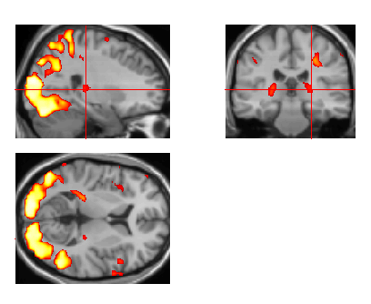
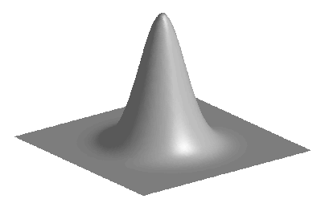
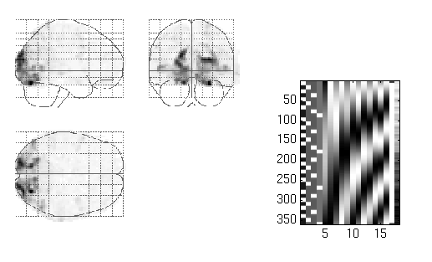
segmentation
and normalisation
posterior probability
maps (PPMs)
dynamic causal
modelling
multivariate
decoding
realignment
smoothing
general linear model
statistical
inference
Gaussian
field theory
normalisation
p <0.05
template

Slide 35
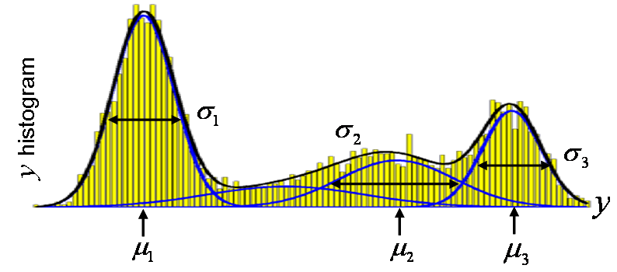
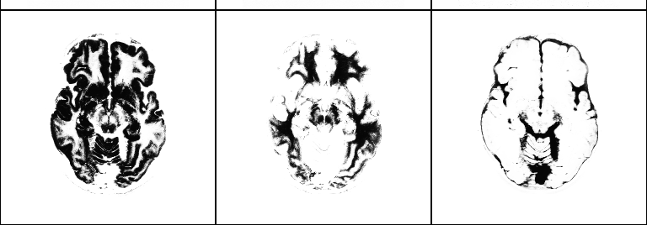
Segmentation (mixture of Gaussians-model)
class variances
…
i^{th} voxel
label
…
i^{th} voxel
value
class
frequencies
class
means
grey matter
white matter
CSF

Slide 36
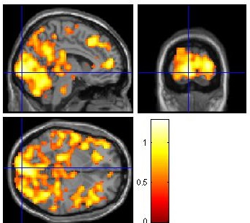
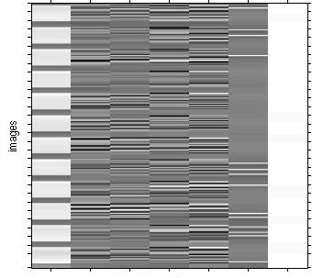
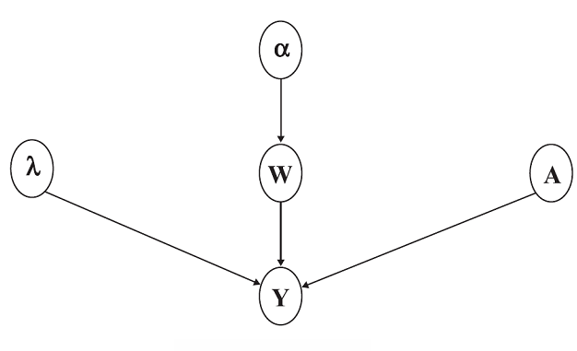
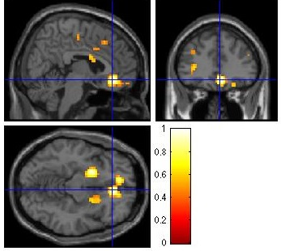
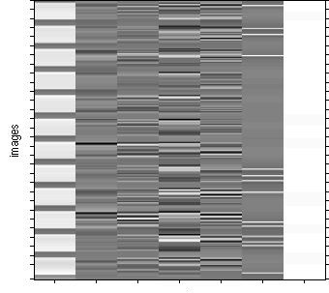
fMRI time series analysis
PPM: regions best explained
by short-term memory model
short-term memory
design matrix (X)
prior variance
of GLM coeff
prior variance
of data noise
AR coeff
(correlated noise)
GLM coeff
PPM: regions best explained by long-term memory model
fMRI time series
long-term memory
design matrix (X)

Slide 37
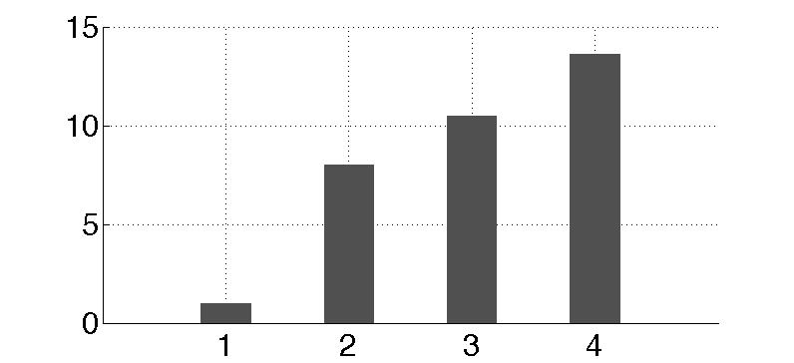
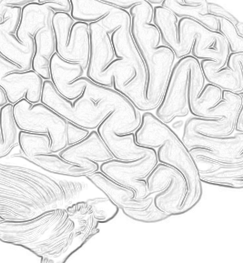
Dynamic causal modeling (DCM)
m₁
m₂
m₃
m₄
attention
attention
attention
attention
PPC
PPC
PPC
PPC
stim
V1
V5
stim
V1
V5
stim
V1
V5
stim
V1
V5
attention
models marginal likelihood
0.10
estimated
effective synaptic strengths
for best model (m₄)
15
PPC
0.39
10
1.25
0.26
stim
0.26
V1
0.13
V5
5
0.46
0
m₁
m₂
m₃
m₄

Slide 38
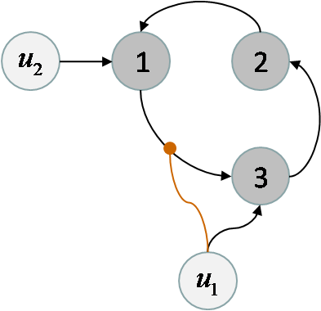
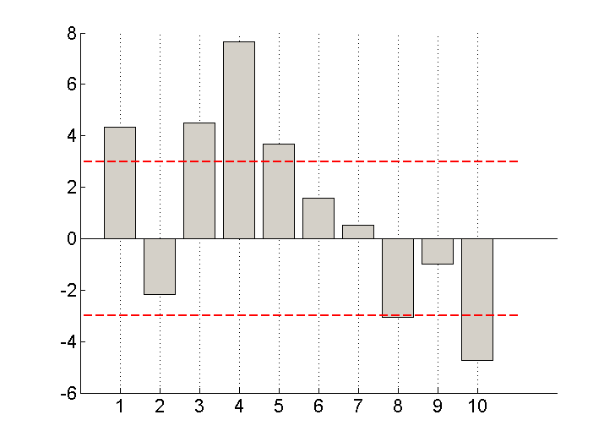
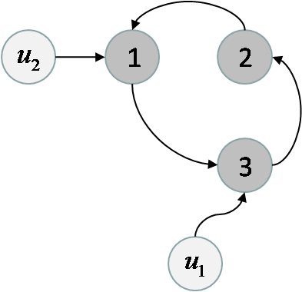
Model comparison for group studies
m₁
differences in log- model evidences
m₂
subjects
Fixed effect
Assume all subjects correspond to the same model
Random effect
Assume different subjects might correspond to different models

Slide 39
Thanks

